Slide 1
In total, how many user-defined fonts can exist together?
For CCSID 937 (Traditional Chinese), there are 6204 codes for user-defined fonts:
  for C2: C241 to C2FD = 188 (C280 excluded)
  for C3: C341 to C3FD = 188 (C380 excluded)
  for C4, C5,… up to
  for FD: FD41 to FDFD = 188 (FD80 excluded)
  There are 33 ranges from C2 to FD, so 188 x 33 = 6204 codes for user-defined fonts

Slide 2
Display or print all fonts of a font file

Slide 3
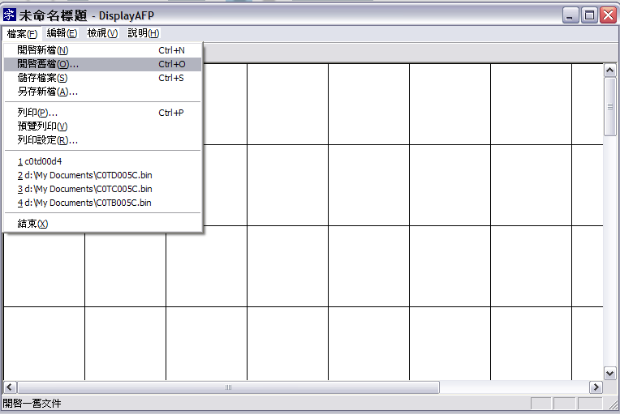

Slide 4
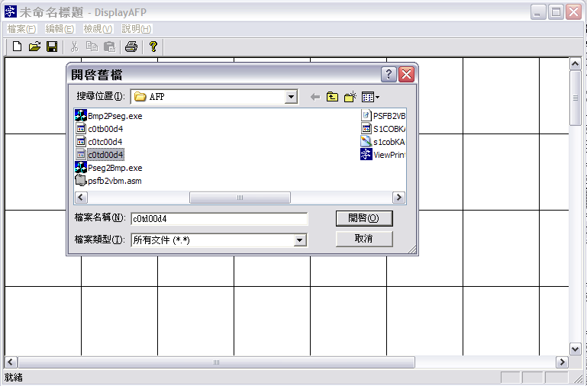

Slide 5
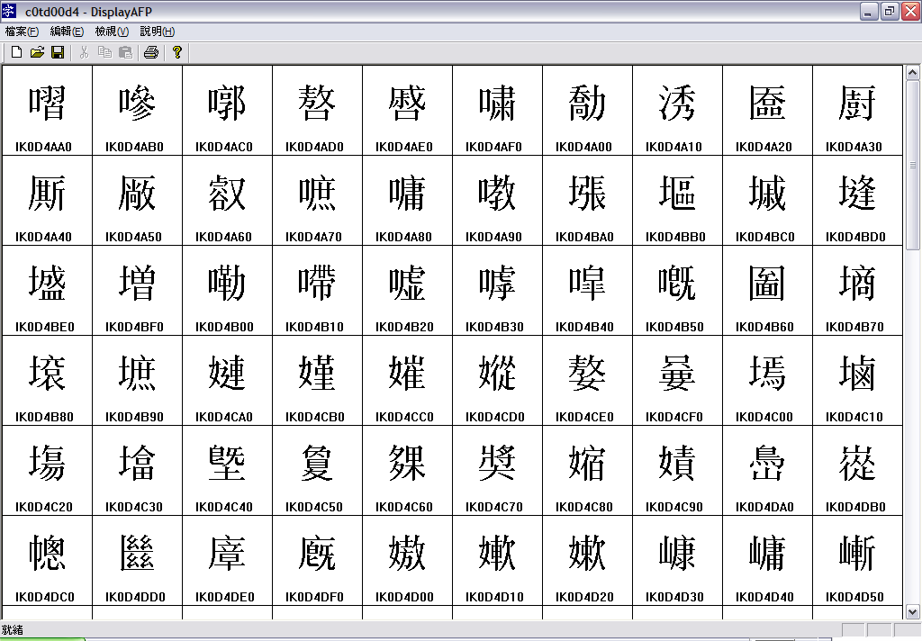

Slide 6
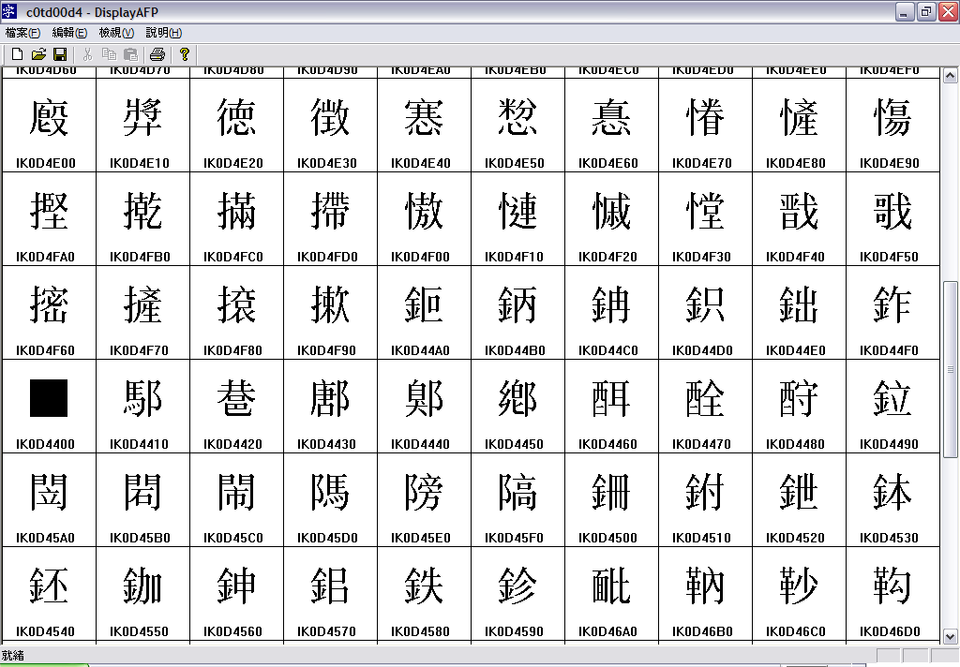

Slide 7
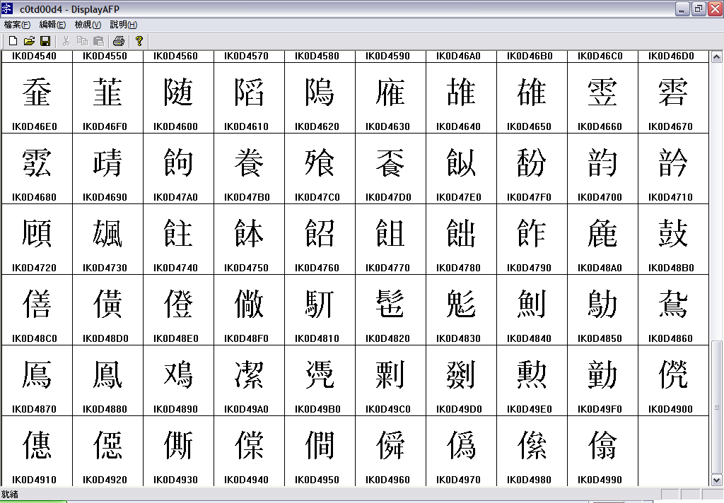

Slide 8
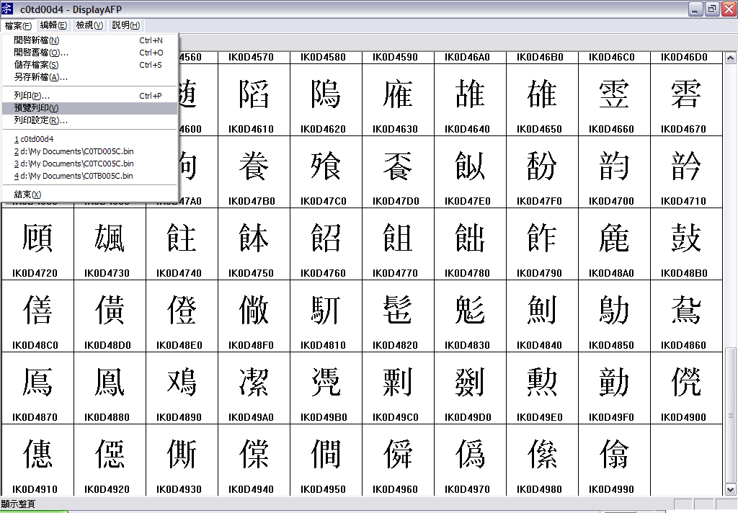

Slide 9
